Slide 1
GSMPL EBITDA Project – Scope
www.tcgdigital.com

Slide 2

Agenda
Project Overview
01
FCC Module
06
EBITDA Calculation
02
Corporate Expenses Module
07
High Level Solution Diagram
Sales and Net Sales
03
08
Raw Material and Melt Module
04
Value Proposition
09
VCC Module
05

Slide 3
Project Overview
The objective of this exercise is to develop a clear and transparent methodology to calculate GSMPL’s daily and monthly EBITDA, ensuring alignment across sales, cost, and margin elements, and enabling effective future tracking of profitability drivers.
Current pain points
1. Lack of Real-Time View
No automated link between sales realization, raw material consumption, and margin impact.
Teams cannot see day-to-day margin fluctuations quickly.
2. Delayed Visibility of Profitability
EBITDA is currently derived after multiple reconciliations.
Management often gets lagged profitability insights, limiting proactive decision-making.
3. Limited Product-Level Insights
Profitability is tracked at an aggregate level in Excel.
Difficult to drill down into product-wise, SKU-wise EBITDA drivers.
4. Cumbersome Month-End Closing
Effort-intensive reconciliations between sales, procurement, and finance slow down month-end closing.
Increases pressure on finance teams and delays reporting to leadership
.
Project Overview

Slide 4
EBITDA Calculation
Total Sales | Sales Qty Domestic + Sales Value Domestic + Sales Qty Export + Sales Value Export + Waste Sale/Others
Sales & Distribution Expenses | Outward Freight + Ocean Freight + Commission + Cash Discount + Rate Discount + Internal Freight + Warehouse charges
Net Sales | Total Sales- Sales & Distribution Expenses
Melt | Melt = PTA + MEG/ Other Raw Materials cost including Conversion cost
Gross Margin | Net Sales - Melt
Subtotal VCC | Power + Heating + Antimony + Additives & chemicals + Packing materials + Procured RM (Chips, spandex- Other than PTA & MEG)) + NRV + Inventory Cost + Other VCC
Contribution | Gross Margin/spread - Subtotal VCC (Variable Cost)
Subtotal FC Conversion cost | Stores & repairs + Manpower (Payroll) + Contract Manpower + Insurance + Overheads
Margin Jolwa | Contribution - Subtotal FC Conversion cost - Internal shifting of SFG (Or any other unallocated cost of Jolwa)
Subtotal corporate Expense | Corporate Expense Payroll, Other Expenses
EBITDA | Margin Jolwa - Subtotal corporate Expense
Breakdown: Full support for SKU, product, and plant-wise allocation; reportable per kg for fine granularity.
Reporting Frequency: Generates daily, month-to-date, and “T-2” (two days lag) management dashboards.
Important Points:
Decision to be tajen : How to take care of the Common Cost center expenses at SKU/Product Level ?

Slide 5
Sales & Net Sales
Sales Data Sources:
Directly sourced from SAP, reflecting Domestic, Export, and Waste/Other sales. Sales quantity and value are captured separately for each segment and product SKU.
Key Adjustments:
Sales Returns: SAP entries adjust sales on the actual return date.
Dealer Commission & Rate Differences: Fetched at invoice level and allocated per SKU.
Waste Sales: Classified under "Others," mapped using specific SAP waste codes pending more granular SKU mapping.
Distribution Expenses: Include Outward Freight, Ocean Freight, Commission, Cash Discount, Rate Discount, Internal Freight, and Warehouse Charges.
Net Sales Formula:
Net Sales=Total Sales−Sales Distribution Expenses
Reporting: Drill-downs possible, and credits or adjustments are posted by date for monthly closing.
Sales Total Value= (Sales Value Domestic+ Sales Value Export)−Sales Returns Value−Dealer Commission ± Price/Rate Differences
Net Sales = Sales Total Value – Sales Distribution Expenses

Slide 6
Melt (PTA & MEG) Module
Logic:
Consumption mapped through BOM: Each SKU’s daily output × BOM factor gives PTA/MEG consumption.
Pricing: Initially uses last costed price, adjusted at month-end with actual procurement rates.
Consumption Mapping:
BOM defines the standard consumption of PTA for each SKU.
With the daily production plan, PTA consumption is derived by multiplying the SKU output quantity by the BOM consumption factor.
This allows automated mapping of consumption to SKU on a daily basis.
Manual Rate Handling
Until actual cost is finalized, the last manual entry of PTA rate (standard price) will be used for daily costing.
The same manual rate continues till it is updated, ensuring consistency.
Comment: Tracks impact of raw material volatility and aligns cost allocation dynamically.
Gross Margin= Net Sales−Melt Raw Material Cost

Slide 7
Variable Cost Contribution (VCC) Module
Components: Power, Heating, Antimony, Additives/Chemicals, Packing Material, Procured RM Chips & Spandex, Other VCC.
Power: Calculated as per plant and production line. Rate and quantity norms are maintained in the system and multiplied with plant-wise correction factors.
Heating: Merge Factor applied per SKU to establish required heating quantity, then costed at the latest manual rate.
BOM Mapping: Antimony, Additives, Chemicals, and Packing are tracked by combining quantity (from BOM/production plans) with rates from SAP/material masters.
Procured RMs: Last cost from SAP material master × actual usage.
NRV and Inventory Cost : NRV is defined as the estimated selling price of an asset in the ordinary course of business, less the expected costs necessary to complete and sell the asset
NRV=Estimated Selling Price − Costs to Produce − Costs to Sell.
Inventory Cost will be calculated for EBITDA
Other VCC: Plant-wise consumable costs split using merge factors for SKU-wise allocation.
Highlights: Ensures daily, SKU-level allocation with audit trails for all variable costs.
Contribution= Gross Margin−Total VCC

Slide 8
Fixed Cost Conversion Module
Components: Stores & Repairs (SAP), Manpower Payroll (Manual), Contract Manpower (IGMS + SAP), Insurance (Manual), and Overheads (Manual/historical).
Allocation: Fixed costs mapped to SKUs via merge factors or production distribution logic. Payroll can be adjusted with factors for leaves or overtime.
Insurance: Two options—(1) Upfront allocation as per planned sales quantity per SKU/product or (2) Daily spread using recurring monthly journals.
Comment: Provides daily control and transparency over plant-level conversion costs.
Internal Shifting Cost of SFG
Definition: Margin after variable and fixed costs, key performance indicator for Jolwa (primary producing) site.
Adjustments: Accounts for "Internal Shifting of SFG" (semi-finished goods), with COGM and opening stock handled based on SAP data and production postings.
Purpose: Crucial for site and product profitability analysis. Jolwa plant in scope, with options to extend logic to other sites.
SAP Integration: Weighted average of COGS maintained daily for accuracy.
Margin at Jolwa = Contribution−Total Fixed Cost Conversion−Internal Shifting Cost of SFG

Slide 9
Corporate Expenses Module
Components: Corporate Payroll, Other Corporate Expenses, Corporate Income.
Modeling: Allocated using last month/quarter averages, grouped under four cost centers. Can be bucketed as "Others" or given dedicated reporting heads based on management decision.
Purpose: Segregates headquarters costs from operational plant costs, allowing cleaner plant performance tracking.
Total Corporate Expenses= Corporate Expense Payroll + Corporate Expense Others - Corporate Income
EBITDA = Margin at Jolwa – Total Corporate Expenses

Slide 10
Key Process Highlights
More than 500 SKUs handled with flexibility for cost forecasting, SKU-level drill downs, and daily margin tracking.
Dynamic integration between SAP, IGMS, and manual controls ensures comprehensive cost capture and management review-ready reporting.
Designed to support margin maximization, process efficiency, and proactive management decision-making at all levels
The EBITDA application will fetch required information from S&OP application and will calculate the projected EBITDA. So, the projected feature will be delivered post Go-Live of S&OP module.

Slide 11

High Level Solution Diagram
Rules and Validation Engine
EBITDA 360 Orchestration service
SAP
Sales and Realization Module
Output : Net Sales
EBITDA 360 database
Data ingestion via API,ETL, file upload, RFC, etc
Raw Material and Melt Module
Output : Gross Margin
Manual Webform
Variable Conversion Cost Module
Output : Contribution
Fixed Conversion Cost Module
Output : Margin at Jolwa
Corporate Expense Module
Output : EBITDA

Slide 12
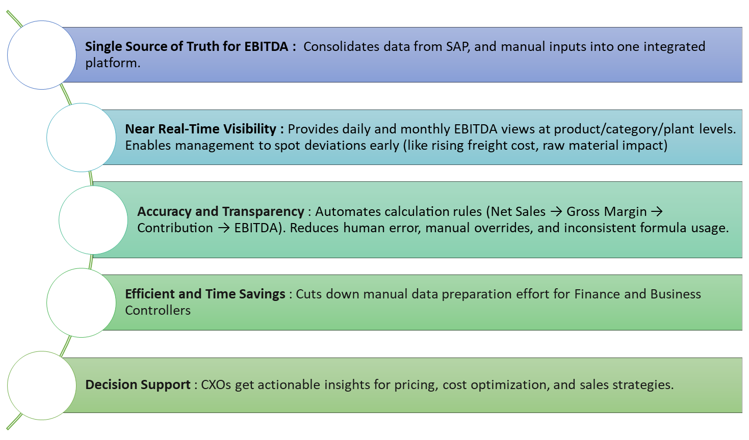

Value Proposition

Slide 13




ABOUT TCG DIGITAL
TCG Digital is the digital & AI arm of The Chatterjee Group (TCG), a multi-billion dollar conglomerate with a diverse portfolio in Pharmaceuticals, Biotech, Petrochemicals, and Real Estate across the US, EU, and South Asia. Our umbrella includes companies such as LabVantage, Lummus Technology, and TCG LifeSciences. At TCG Digital, we are driven by our mantra of delivering "Velocity to Value", helping enterprises transform faster and smarter. Our AI Analytics platform tcgmcube is at the heart of these transformations. We enable organizations unlock the full potential of their data, and by seamlessly integrating AI/ML capabilities into their business processes, we empower businesses to accelerate their digital transformation journey, enhancing agility and driving impactful results.
TCG Digital Solutions LLC
265 Davidson Ave, Suite 220 Somerset New Jersey 08873
+1 (732) 515-7376
contact@tcgdigital.com
www.tcgdigital.com

